Slide 1
Acid-Base Balance

Slide 2
Objectives:
Introduction to the acid-base balance
Systems responsible for the maintenance of the acid-base balance
Basic disorders of the acid-base balance and means of compensation

Slide 3
Acid-base balance is very important for the homeostasis of the body
almost all the physiological activities depend upon the acid-base status of the body.

Slide 4
Acid
Any compound which forms H⁺ ions in
solution (proton donors)
eg: Carbonic acid releases H⁺ ions
Base
Any compound which combines with H⁺ ions in solution (proton acceptors)
eg: Bicarbonate(HCO3⁻) accepts H+ ions

Slide 5
Acids and bases can be:
Strong : dissociate completely in solution HCl, NaOH
Weak : dissociate partially in solution Lactic acid, carbonic acid

Slide 6
Acid–Base Balance
The pH is term used for H⁺ concentration
Negative logarithm of H⁺ concentration is taken for calculating the pH as given below.

Slide 7
An increase in H⁺ ion concentration decreases the pH and a reduction in H⁺ concentration increases the pH .
An increase in pH by one fold requires a tenfold decrease in H⁺ concentration

Slide 8
Acid–Base Balance
Normal pH : 7.38-7.42 , Average (7.4)
Acidosis
Physiological state resulting from abnormally low plasma pH (pH < 7.35= acedemia)
Alkalosis
Physiological state resulting from abnormally high plasma pH ( pH > 7.45= alkalemia)
pH < 6.8 or > 8.0 lead to death

Slide 9
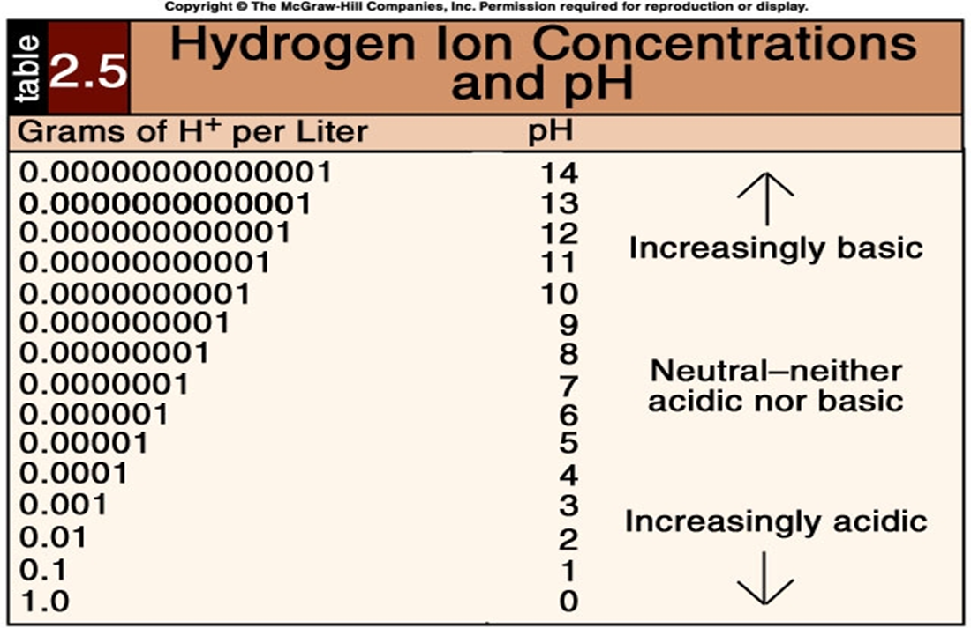

Slide 10
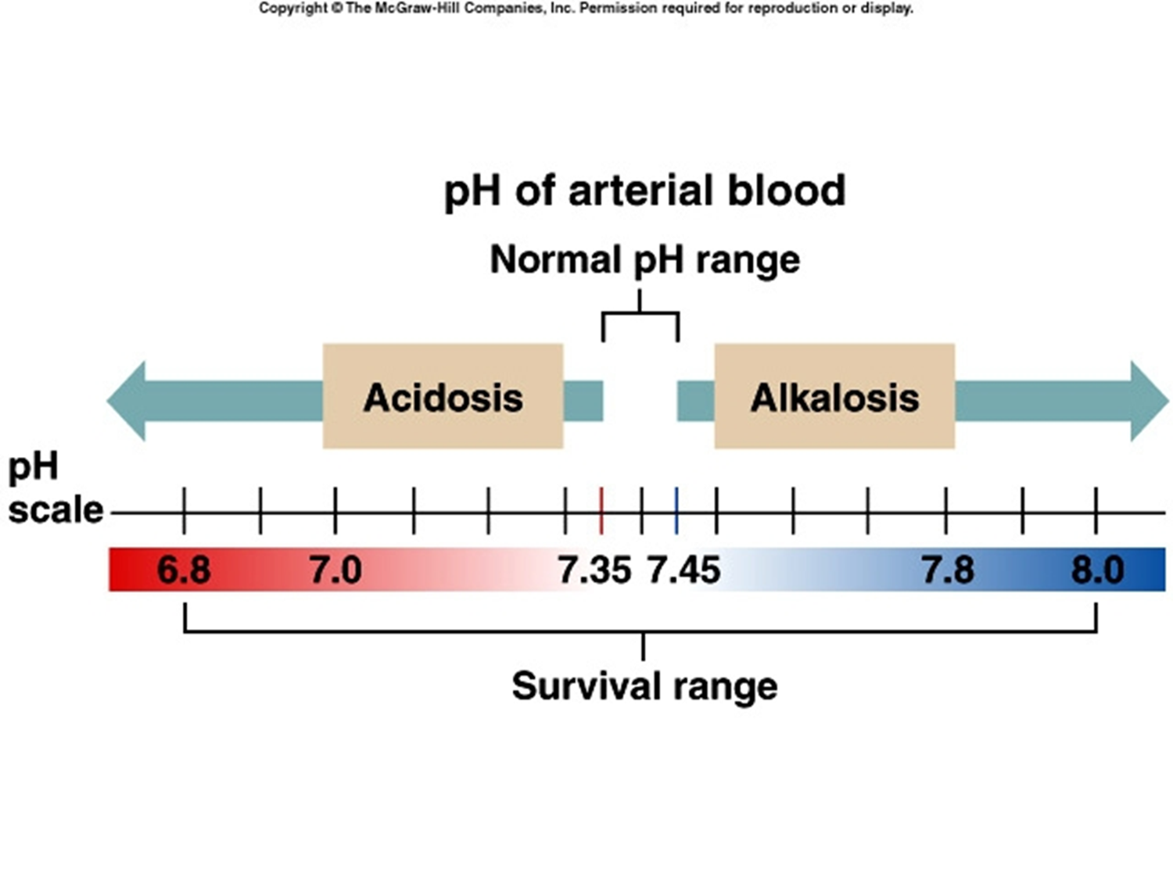

Slide 11
Extensive deviations of pH value can affect:
enzymes
( change of protein structure )
membranes permeability.
electrolyte distribution.

Slide 12
The body produces more acids than bases.
Sources of acids in body:
Ingestion of acidifying salt with foods
Fixed acid e.g. H₂SO₄
Organic acid (Lactic acid )
Cellular metabolism produces CO2.
CO2 + H20 ↔ H2CO3 ↔ H⁺ + HCO3⁻

Slide 13
Sources of Alkali in the body:
Loss of gastric acid
Ingestion of alkalinizing salt
Ingestion of fruits rich in alkaline

Slide 14
Mechanisms of regulation of acid base balance
Include three lines of defense mechanisms:
Buffer system
Respiratory system
Renal system

Slide 15
1-Buffer systems
Buffer is a chemical substance formed of weak acid and alkali act to resist changes in pH.
buffer is a substance that has the ability to bind or release hydrogen ions in solution , thus keeping the pH relatively constant despite the addition of considerable quantities of acid or base .

Slide 16
Types of buffers:
A-Bicarbonate buffer
HCl + NaHCO3 ↔ H2CO3 + NaCl
NaOH + H2CO3 ↔ NaHCO3 + H2O
B- Phosphate buffer
Major intracellular buffer
H+ + HPO42- ↔ H2PO4-
OH- + H2PO4- ↔ H2O + H2PO42-
C-Protein Buffers
Includes hemoglobin

Slide 17
2. Respiratory mechanisms
Exhalation of carbon dioxide
Body pH can be adjusted by changing rate and depth of breathing

Slide 18
3. Kidney excretion
Can eliminate large amounts of acid
and excrete base
Can conserve and produce bicarbonate ions
Most effective regulator of pH
If kidneys fail, pH balance fails

Slide 19
Correction of PH changes
Buffers function almost immediately
Respiratory mechanisms take several minutes to hours
Renal mechanisms may take several hours to days

Slide 20
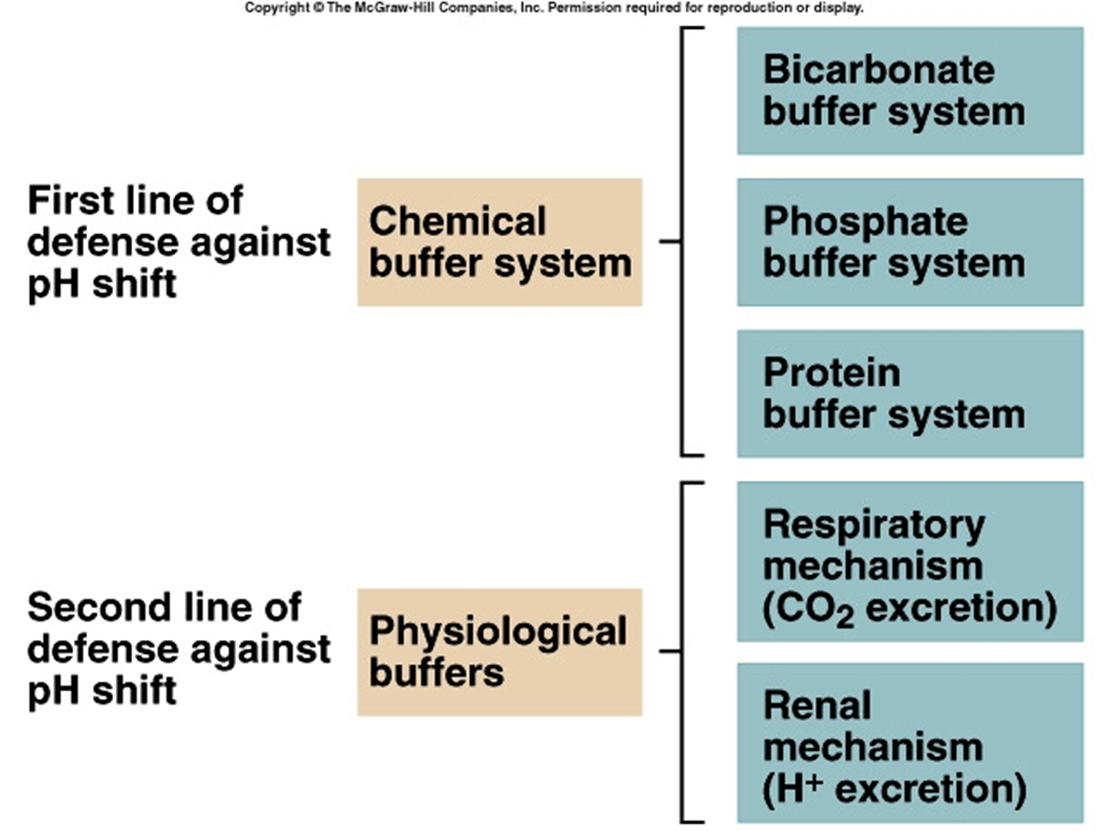

Slide 21
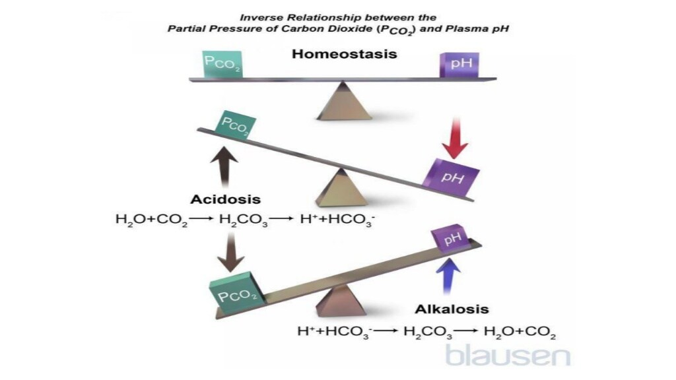
Acid-Base Imbalances
pH< 7.35 acidosis
pH > 7.45 alkalosis
The body response to acid-base imbalance is called compensation

Slide 22
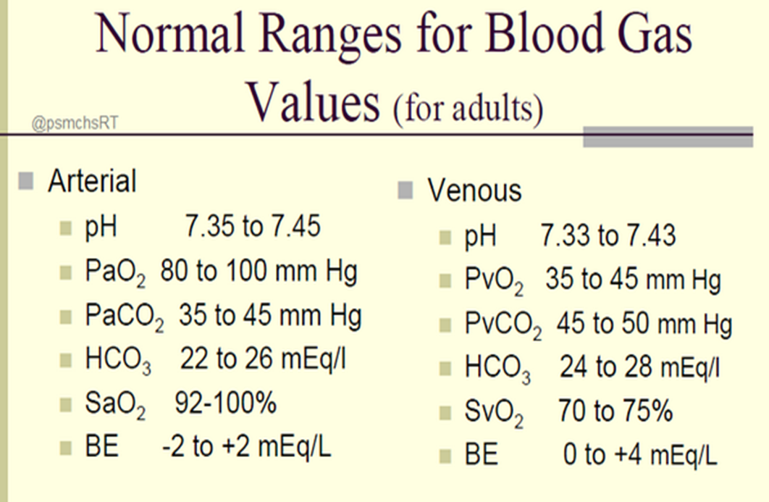

Slide 23
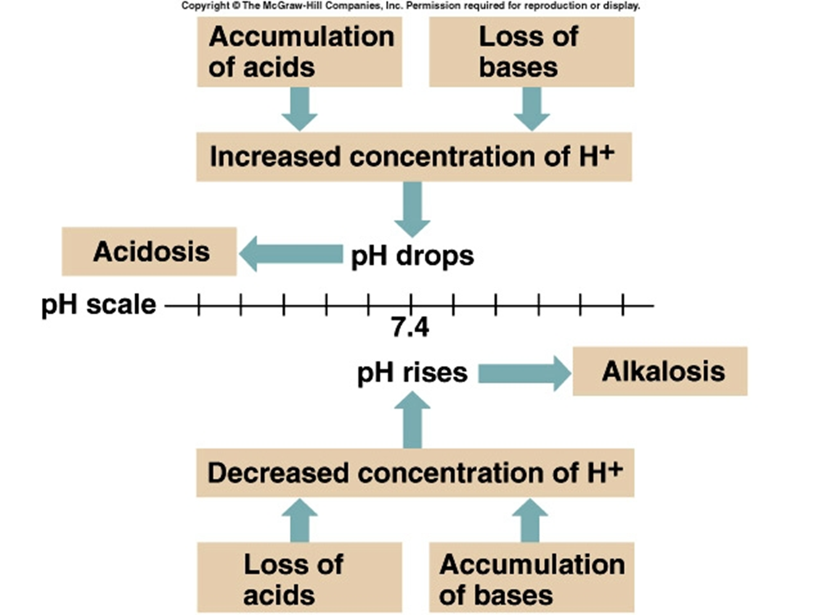

Slide 24
Four Basic Types of Imbalance
• Metabolic Acidosis
• Metabolic Alkalosis
• Respiratory Acidosis
• Respiratory Alkalosis

Slide 28
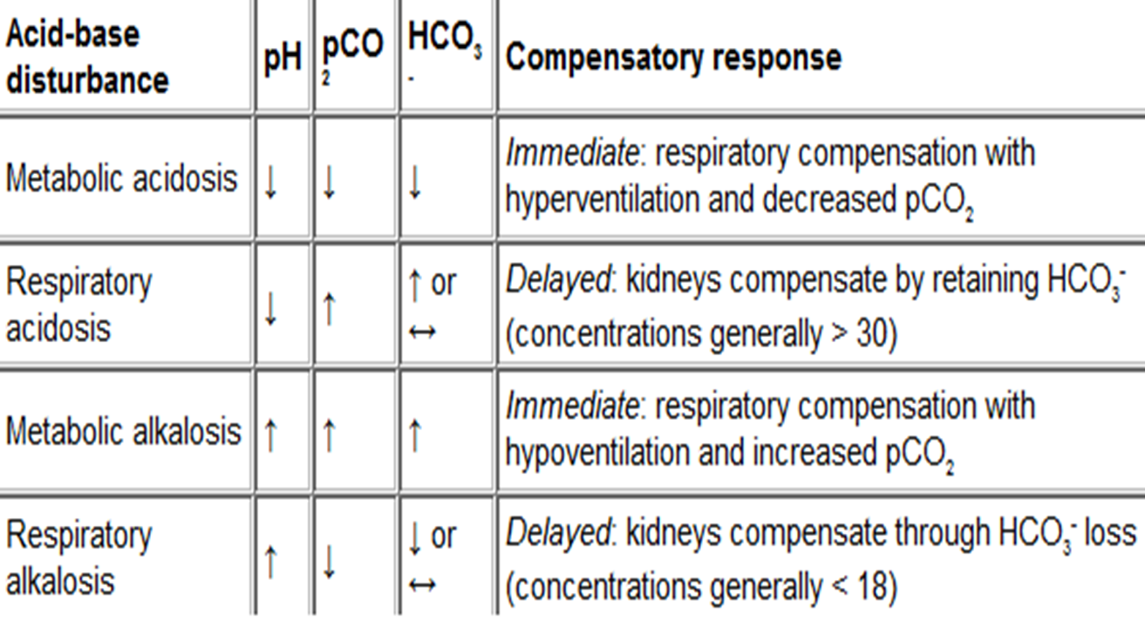

Slide 30
Anion gap:
is the difference between the sum of anions and cations in ECF
calculated as : {[Na+] + [K+ ]} _ {[Cl- ] + [HCO3-]}
normal value = 8 - 16 mEq
Used to distinguish between the type of metabolic acidosis

Slide 31
problem
A patient is in intensive care because he suffered a severe myocardial infarction 3 days ago. The lab reports the following values from an arterial blood sample:
pH 7.3
HCO3- = 20 mEq / L ( 22 - 26)
pCO2 = 32 mm Hg (35 - 45)

Slide 32
Diagnosis
Metabolic acidosis With compensation

Slide 33


